Slide 1



Slide 2

Introduction
Face biometrics are used by everyone every day.
The face is the first defining characteristic that we use to identify someone.
The face is made up of many distinct micro and macro elements.
The macro elements include the mouth, nose, eyes, chin, lips, forehead, and ears.

Slide 3
Introduction
The micro features include the distances between the macro features, or a reference feature and the size of the feature itself.
Also, unseen to the human eye is the fact that our bodies and faces radiate heat, which can be measured by using infrared cameras.
All these features can be used by face biometric systems to help identify and authenticate someone

Slide 4
How Is the Face Imaged?
Facial images can be captured either through a live scan or through the use of photographs or video.
Cameras that are currently usable for network security access are generally the same ones used for desktop video conferencing.
They are low in cost since they use popular CCD and CMOS image technologies.
They are also small enough to be deployed on a desktop.
Also, they do not require any special imaging boards and they support standard connections like USB.

Slide 5
What Types of Algorithms Are Used for Facial Interpretation?
The algorithms used to match and enroll a face fall into the following categories:
Eigenface
Local feature analysis
Neural network
Automatic face processing

Slide 6
Eigenface
Eigenfaces is the name given to a set of eigenvectors when they are used in the computer vision problem of human face recognition.
The algorithm works from two-dimensional grayscale images.
From a grayscale image, an Eigenface is extracted.
The face is then mapped to a series of Eigenvectors, which are mathematical properties describing the unique geometry of that particular face, forming the biometric template.

Slide 7
Eigenface
The template is then compared to the generated Eigenfaces for comparison.
The degree of variance between the template and the reference Eigenfaces determines a match.
The lower the variance between the template and the reference Eigenfaces, the greater the likelihood of a match.
To create the reference template that the live template is compared to, it builds a composite of all enrolled faces.

Slide 8
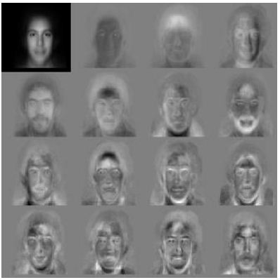
Eigenface
This means that as more faces are added to the database, the reference template is updated.

Slide 9
Local feature analysis
Local feature analysis uses the macro features of the face as reference points.
The algorithm first locates the face from its surroundings.
The reference points are then located by using the change in shading around each feature.

Slide 10
Local feature analysis
Once a change in shade is found, it is defined as an anchor point.
Once all the anchor points are found, the algorithm creates triangles that tie together the anchor points.
The angles of the triangles from each anchor point are measured and a template is generated.
When a live facial scan is done, a new template is created using local feature analysis; this new template is compared against the reference templates.

Slide 11
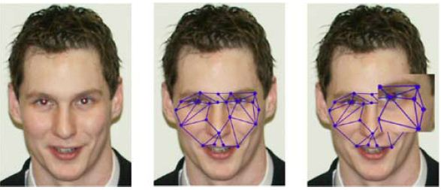
Local feature analysis
The higher the percentage of the comparison, the greater the likelihood that the live template and the reference template will match.

Slide 12
Local Feature Analysis
To determine someone's identity,
the computer takes an image of that person and
determines the pattern of points that make that individual differ most from other people. Then the system starts creating patterns,
either randomly or based on the average Eigenface.

Slide 13
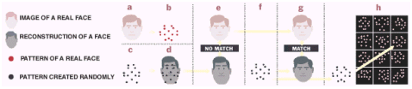
Local Feature Analysis
(d) For each selection, the computer constructs a face image and compares it with the target face to be identified.
New patterns are created until facial image that matches with the target can be constructed.
When a match is found, the computer looks in its database for a matching pattern of a real person, as shown below.

Slide 14
Neural Network
The brain consists of a densely interconnected set of nerve cells, or basic information-processing units, called neurons.
The human brain incorporates nearly 10 billion neurons and 60 trillion connections, synapses, between them.
Each neuron has a very simple structure, but an army of such elements constitutes a tremendous processing power.
A neuron consists of a cell body, soma, a number of fibers called dendrites, and a single long fiber called the axon.

Slide 15
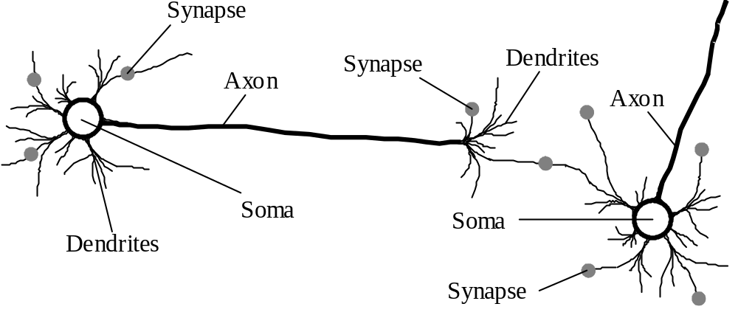
Biological neural network

Slide 16
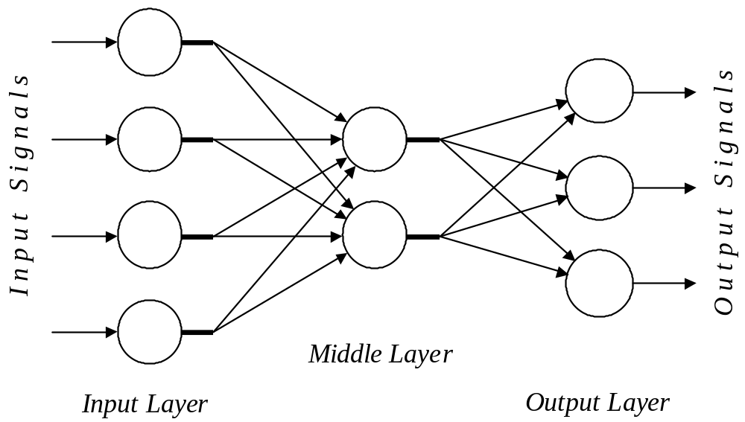
Architecture of a typical artificial neural network

Slide 17
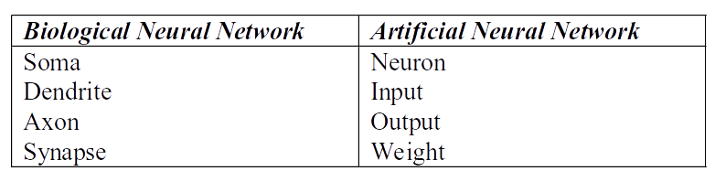
Analogy between biological and
artificial neural networks

Slide 18
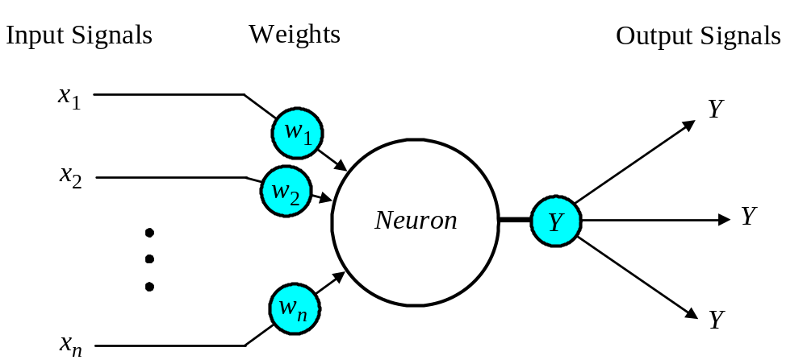
The neuron as a simple computing element

Slide 19
Neural Network
The neural network algorithm is patterned after the synapses and neurons in the human brain.
By creating an artificial neural network (ANN), problems can be solved based on training the network.
To train the network, a series of captured faces are fed into the network.
Each face has its macro features identified.

Slide 20
Neural Network
In addition to having faces with identified features, other random images are added to the training set.
The random images added to the training set cause the ANN to learn what does not constitute a face.
Then, as the ANN begins to learn, faces are entered into the system that do not have their macro features identified.

Slide 21
Neural Network
The unidentified faces that fail to match are re-entered into the system with identified features.
The ANN is made up of the following parts:
Face detection and framing
ANN input level
Receptive fields
Hidden units
Output

Slide 22
Neural Network
Face detection and framing
As a face is imaged, it needs to be separated from its background.
Once the face is isolated from the background, it is framed and transformed to the appropriate size.
ANN Input Level
Once the face is the appropriate size, the face image is put into the ANN input level.

Slide 23
Neural Network
At this point, the face image is converted into pixels to meet the size specifications of the ANN input.
When the image is translated into the neurons that make up the input level, the input neurons are mapped to receptive fields.
For example, receptive neurons may be grouped so that the input neurons can be equally divided into squares and mapped to a single neuron.
This would be a large square area for mapping where general face features can be isolated.

Slide 24








Neural Network
Feature
Extraction
Valid user/
Invalid
user?
Output Layer
Hidden Layer
Features provided to ANN
Input Layer

Slide 25
Neural Network
Hidden units
Hidden units have a one-to-one neuron/receptive field relationship.
Output
The resulting output from the hidden units comes down to a single output neuron.
Based on a previously chosen threshold, an output neuron may indicate a positive face match or a negative face match.

Slide 26
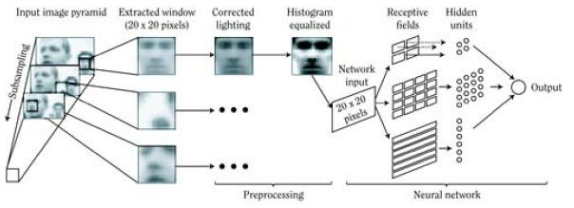
Neural Network
Generalized ANN for face processing.

Slide 27
Automatic Face Processing
Automatic face processing is the simplest of all the facial recognition algorithms.
This algorithm works on the basis of measuring the size of a macro feature and the distances between the macro features of the face.
The resulting ratios that can be created are used to form the facial template.

Slide 28
Which Algorithm Is Best?
The Eigenface algorithm is relatively quick with its searches.
It generally requires good lighting.
It does not deal well with variations in facial expression.
The fact that wearing glasses and beard growth affects the algorithm's ability to authenticate could lead to a large FRR

Slide 29
Which Algorithm Is Best?
Local feature analysis uses macro facial features along with bone structure and changes in shading to define anchor points.
The facial expression is not as critical because the bone structure does not change based on expression.
Since the macro features and bone structure are used as the anchor points, the head does not have to be held still for imaging to occur.

Slide 30
Which Algorithm Is Best?
In general, local feature analysis is very suitable to use as a network security biometric.
Neural network uses a learning method to teach the network how to recognize and differentiate the face.
The algorithm also requires a large database of images to get bootstrapped, and therefore, can be slower in processing the requested face for authentication

Slide 31
Which Algorithm Is Best?
Additionally, the neural network requires a full frontal view of the face with good lighting.
Automatic face processing is a very quick and efficient algorithm.
It appears from our analysis of facial algorithms that local feature analysis is the most suitable for biometric network access.

Slide 32
How Can This Biometric Be Spoofed?
Attacks on a face biometric system fall into the following categories:
Attacking the physical face
Using artifacts
Face biometrics are passive. That is, a biometric sample can be taken from you without your knowledge or consent.

Slide 33
How Can This Biometric Be Spoofed?
There is no real way to know for sure that your image has not been captured.
It is this very thing that makes the face biometric ripe for spoofing.
Facial artifacts are normally in the form of image files that were used by the system during capture.
As such, they could provide a wealth of knowledge and data for replay attacks against a biometric system

